Slide 1


4216 UK Weather Data Analysis
Tuesday 5th April 2022
Cameron Marsh, Ethan Ibrahim,
Laura J. Phillips, Luke Citrine
Luke Curren, Niamh Walsh, Shane Mendis
Cameron Marsh, Ethan Ibrahim,
Laura J. Phillips, Luke Citrine
Luke Curren, Niamh Walsh, Shane Mendis

Slide 2
















Assignment Approach
Resources
Closure & Review
Enablers /
Risks & Issues
Functionality & Scope
Plans & Comms
(UK Data covers England and Wales, only.)

Slide 3
Cameron
Code
In here?
Visualisation here?
What went well
Didn’t go well?
What you learned

Slide 4
Ethan
Code
In here?
Visualisation here?
What went well
Didn’t go well?
What you learned

Slide 5
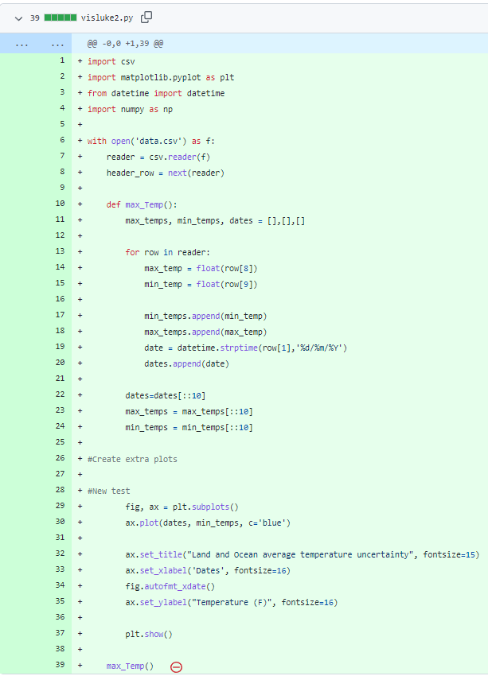
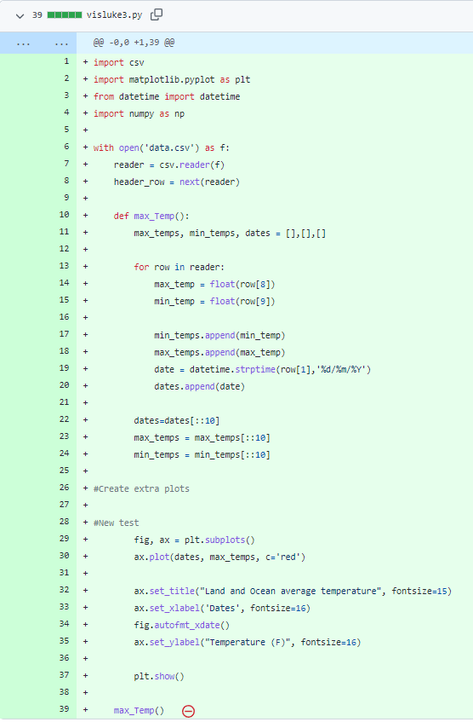
Luke Citrine
Code
In here?
Visualisation here?
What went well
Didn’t go well?
What you learned

Slide 6
Luke Curren
Visualisation here?
Code
In here?
What went well
Didn’t go well?
What you learned

Slide 7
Laura
Code
In here?
Visualisation here?
What went well
Didn’t go well?
What you learned

Slide 8
Niamh
Code
In here?
Visualisation here?
What went well
Didn’t go well?
What you learned

Slide 9
Shane
Code
In here?
Visualisation here?
What went well
Didn’t go well?
What you learned

Slide 10
4216 UK Weather Data Analysis
Tuesday 5th April 2022
Thanks for watching this presentation, today.
Cameron Marsh, Ethan Ibrahim,
Laura J. Phillips, Luke Citrine
Luke Curren, Niamh Walsh, Shane Mendis
Cameron Marsh, Ethan Ibrahim,
Laura J. Phillips, Luke Citrine
Luke Curren, Niamh Walsh, Shane Mendis

